Slide 1
TOP DOWN APPROACH
Presented by Hưng

Slide 2


Table of content
1 What We will find out what is a top-down approach.
2 How How can we use it properly?
3 Why Why is it important?
4 How I apply it in my project

Slide 3
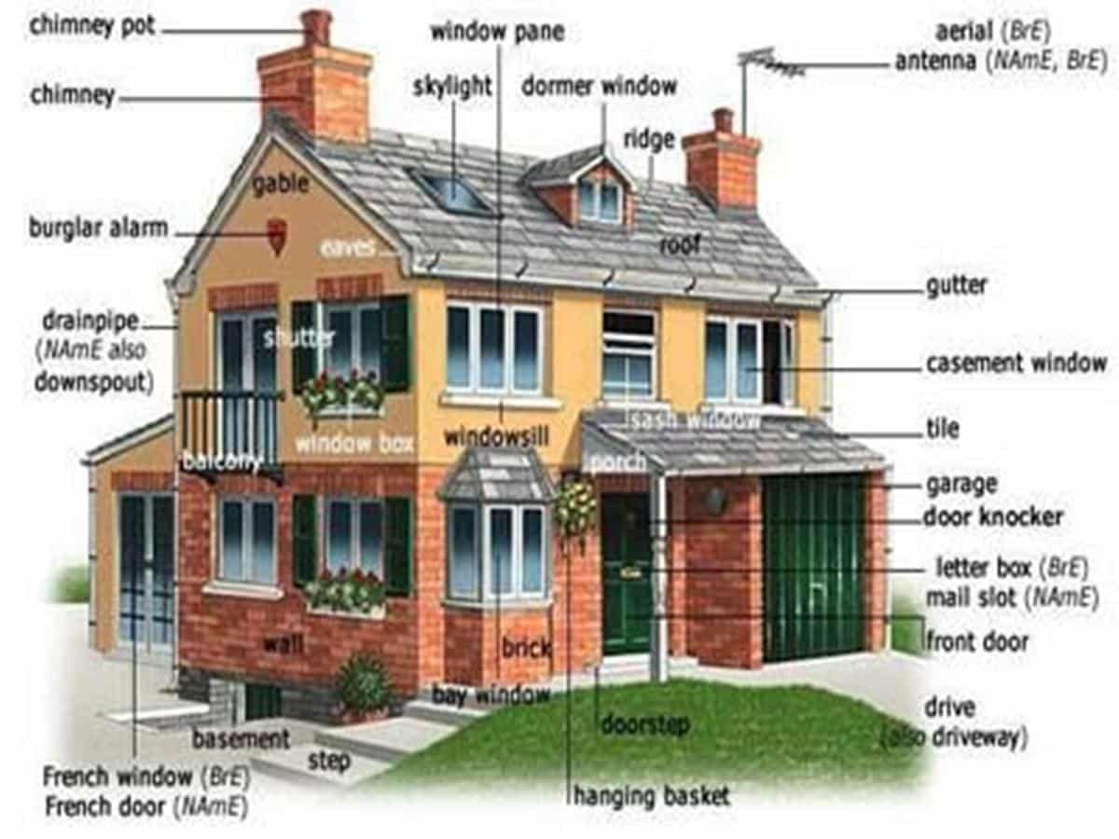
1. What is top-down approach
Imagine you are going to build a big house, what are you going to do first? You don’t know where to start, or what to do?

Slide 4
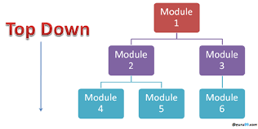
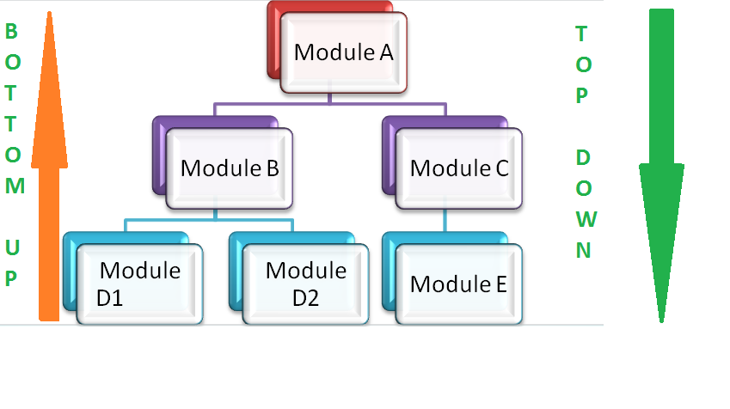
So your solution is top-down approach

Slide 5
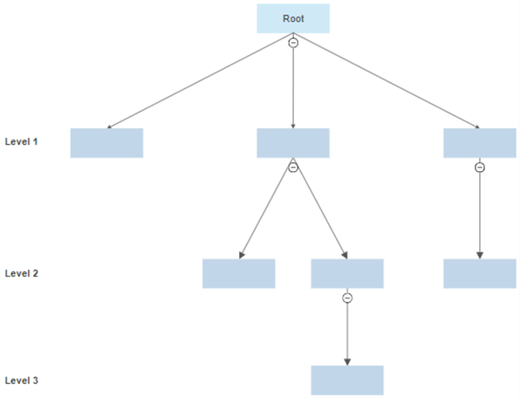
It is a strategy method by which we will: 1) Begin with a broad view of the problems 2) Follow a systematic process from top to bottom. 3) Break the big problem into smaller and more manageable parts. 4) Often used in many fields such as software development, project management, and problem-solving. 5) Often structured in a hierarchical structure
SO WHAT IS TOP-DOWN APPROACH EXACTLY

Slide 6

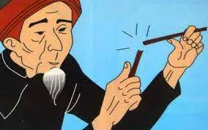
SO WHAT IS TOP-DOWN APPROACH EXACTLY
UNABLE TO BREAK
BREAK EACH ONE EASILY

Slide 7
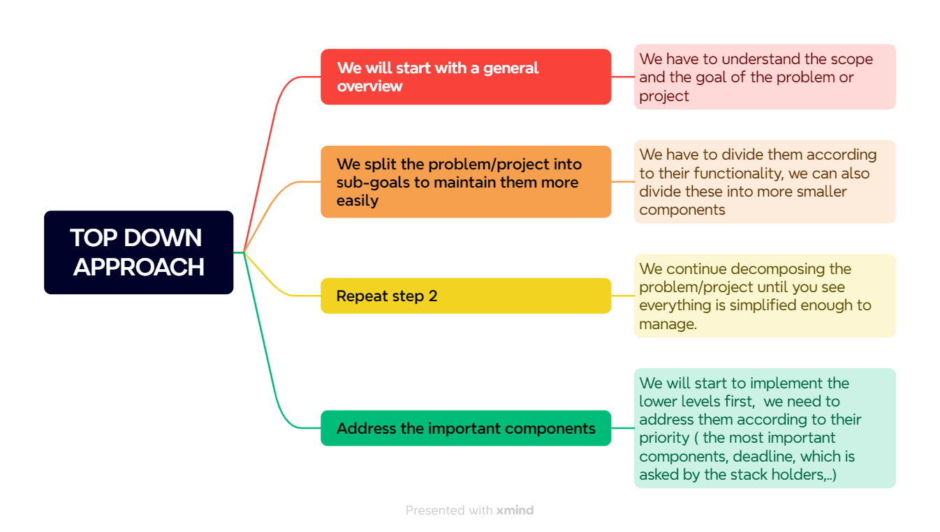
2. How can we use it

Slide 8
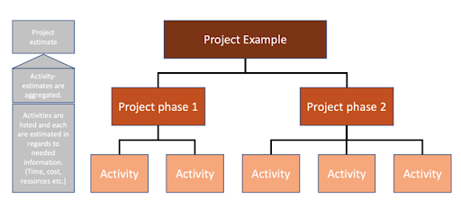
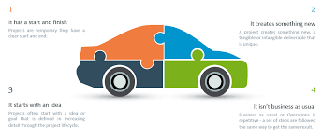
Examples.
Imagine you have a final project, you can apply top-down like this:
1) Split the project into 2 phases (phase one and phase two).
2) In each phrase define the activities or goals you need to achieve.
3) Determine which one is the most important and put it on a to-do list.
4) Integrate these components to build the complete system.

Slide 9

3 WHY IS IT IMPORTANT

Slide 10

ADVANTAGES AND DISADVANTAGES OF TOP-DOWN APPROACH
ADVANTAGES | DISADVANTAGES
We view have a clear view of our goal | Important details are likely to be ignored
Effectively manage the large system | Dependency on initial understanding:
Easier Planning and Coordination | Inflexibility
Easily to identify the key components | Slow to adjust
Quicker implementation | Less creativity
Ideal for a big and complex project | Not ideal for a small project

Slide 11
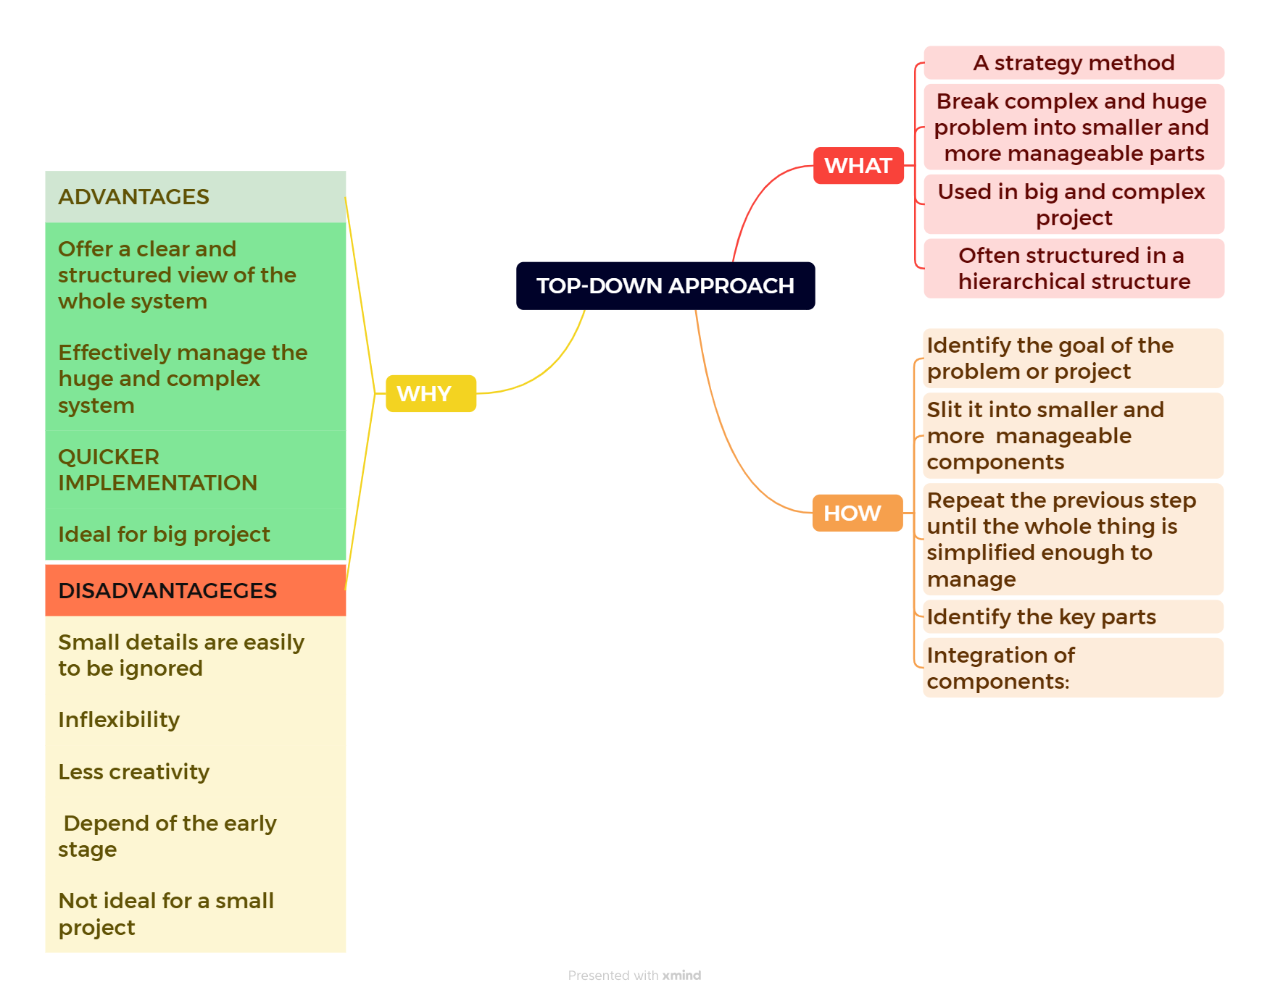
CONCLUSION
CONCLUSION

Slide 12





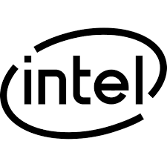
Many companies use the top-down approach in their management and decision-making processes, including:
Google
Microsoft
Apple
Amazon
IBM
Intel
Source: google.com

Slide 13

The Ceo will set an overall vision and strategy for the company. This top-down direction helps align the entire organization toward common goals. Major strategic initiatives, business priorities, and long-term goals are defined at the top. =>Make decisions at highest level and then communicate them to the rest of the team
Google

Slide 14
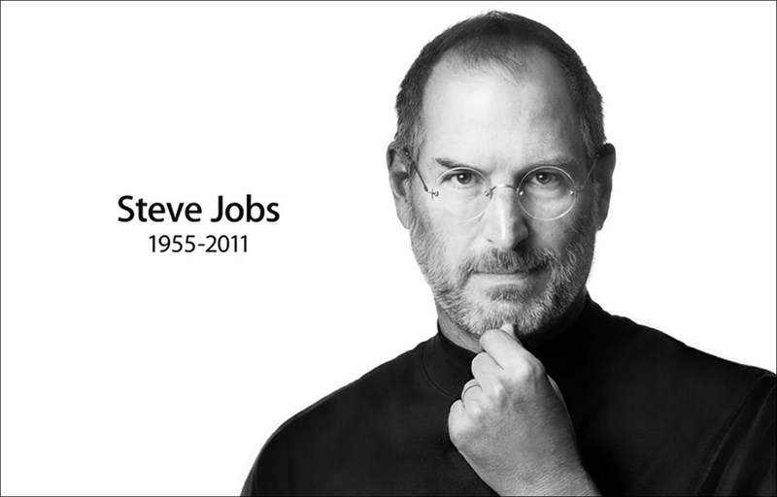
Steve Jobs set the overarching vision and strategy, and then each division within Apple would implement this vision in their work. =>This has resulted in a strong, unified brand and highly coordinated products in terms of design, functionality, and user experience
Apple

Slide 15

Microst is very famous for its clouding service. The decision to shift towards a “Mobile-first, Cloud-first” strategy under the leadership of Satya Nadella is a prime example of a top-down strategy. Recognizing the decline of the traditional PC market and the rise of mobile and cloud computing, Microsoft initiated a strategic pivot that was implemented throughout the company. => As a result, Microsoft has made significant gains in the cloud computing market with its Azure platform.
Microsoft

Slide 16
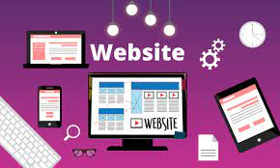
4. How I use it in real life
MY ENGLISH FORUM WEBSITE

Slide 17
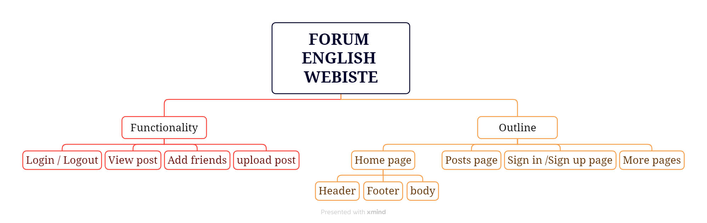

Slide 18
THANK YOU FOR LISTENING

